Slide 1

Non-Functional Requirements

Slide 2
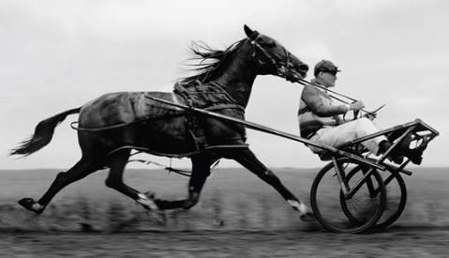
Horse Before The Cart
2 of 9
Notes:
As an organization we move fast
So fast in fact that the cart can get in front of the horse (photo)
Logo (photo)
The ‘illities’ or Non-Functional Requirements
Functional vs Non Functional
Scalability
Perfomability
Monitorabilty
Securiability

Slide 3
Why Are We Here?
3 of 9
Notes:
Aligning Leaders and Teams to New Expectations
The accountability of this process will be on You the Leaders and the Advocates that we pull together for this process.
Quality is not JUST Greg Baker’s job, it’s everyone’s job.
Continuous Improvement Mindset and to quote Josh’s email:
“focus on improving quality in products and processes in 2016”.
NFR’s will help us with this mindset shift.
2015 was great year we released Rocket Mortgage, Darwin etc. and learned a lot in the process.
Realized: we could have done better
For those leaders and teams that DON’T do development
Advocate for this process.
Will help with support (Connect the Threads)

Slide 4





Current NFR Focus
#SECURITY
#DOCUMENTATION
#PERFORMANCE
#CODECOVERAGE
#MONITORING [Coming soon]
4 of 9
Notes:
Our top 4 (with more to come)
Security
Documentation
Performance
Code Coverage
Upcoming:
Monitoring and Alerting
AMP – wip

Slide 5
How Do We Get There?
Review NFR Pamphlet
Visit http://shorty/NFR
Identify Team NFR Advocate (by Jan 1/8)
Update http://shorty/NFRAdvocate
Track Your NFR Related Work
Periodically Review
Rinse & Repeat
5 of 9
Notes:
The Advocate and the TL will be driving the NFR Initiative for the Teams
If your team is having a planning meeting feel free to reach out to us.
JZ’s email: “What gets measured gets improved.”
Will set follow up checkpoints with the advocates
Review NFR Pamphlet
Visit shorty/NFR
Identify Team NFR Advocate (by Jan 1/8)
Update shorty/NFRAdvocate
Track your NFR Related Work.
Periodically Review - Rinse & Repeat

Slide 6
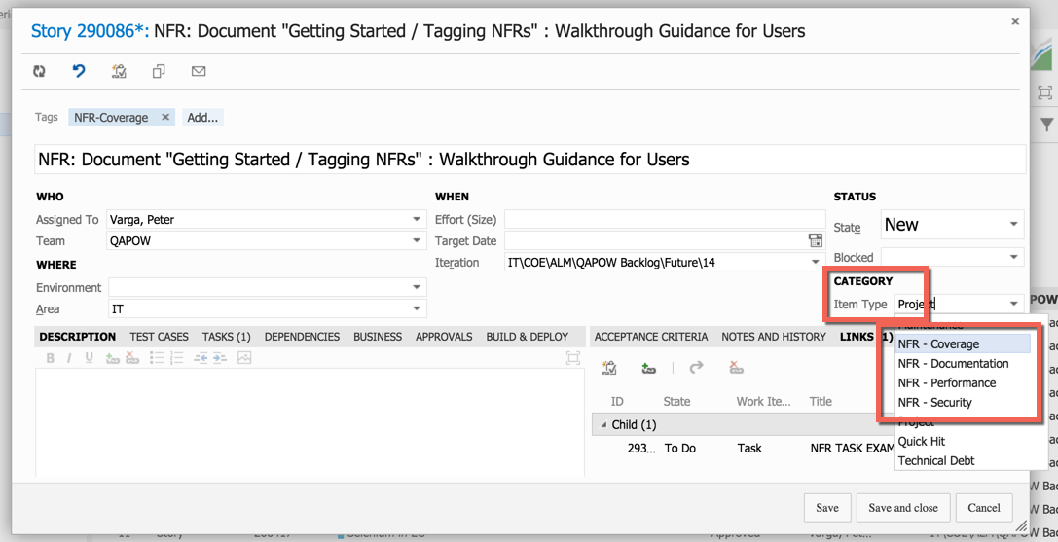
6 of 9

Slide 7
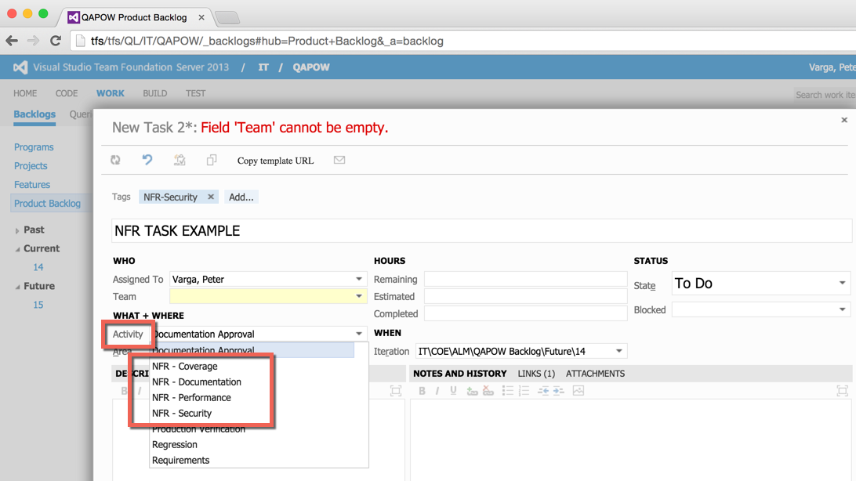
7 of 9

Slide 8
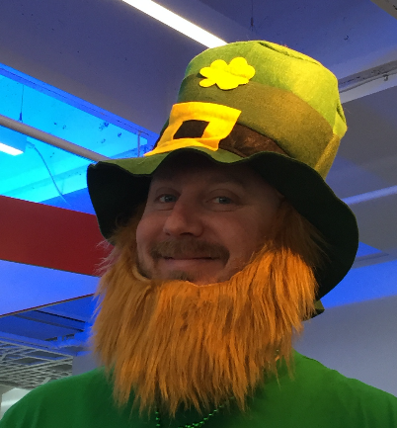
Who We Are:
8 of 9
Notes:
Virtual Team from COE
Charter/Vision: Identify, Build, Evangelize NFRs
Meet on a regular basis and if anyone feels strongly about helping out, let us know!

Slide 9

More Info/Questions
Confluence Page:
http://shorty/NFR
Community:
Hipchat: [Community] NFR
Email: ITCommunityNFR@quickenloans.com
NFR Team:
Email: ITVirtualTeamNFR@quickenloans.com
Done!

